Slide 1
ACCESSING MEDALLIA

Slide 2
Accessing Medallia on Desktop
Accessing Medallia on Mobile
Password Reset

Slide 3
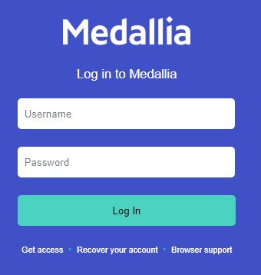
Accessing Medallia Desktop
Instructions
Go to the below URL: https://sebrands.medallia.com/sebrands/
Enter your email as your username and password

Slide 4



Accessing Medallia Mobile
Instructions
Download the app from the App Store or Google Play Store
Select the Medallia 3.0 Mobile App
There may be other Medallia Apps in the app store, only select the Medallia 3.0 Mobile App
OR

Slide 5
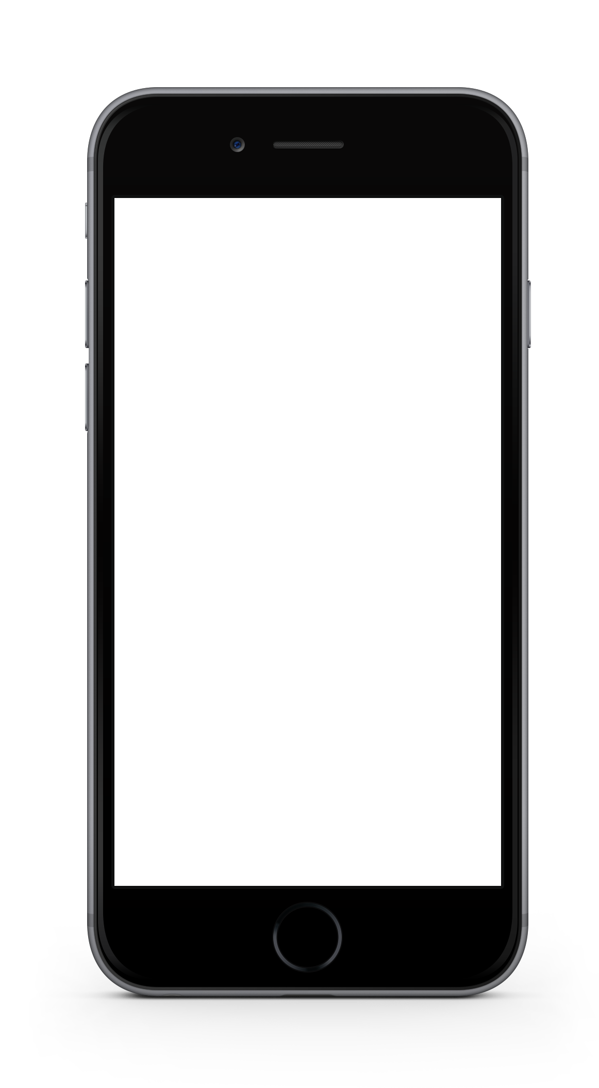
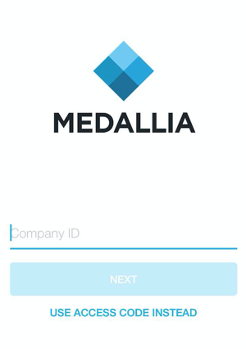
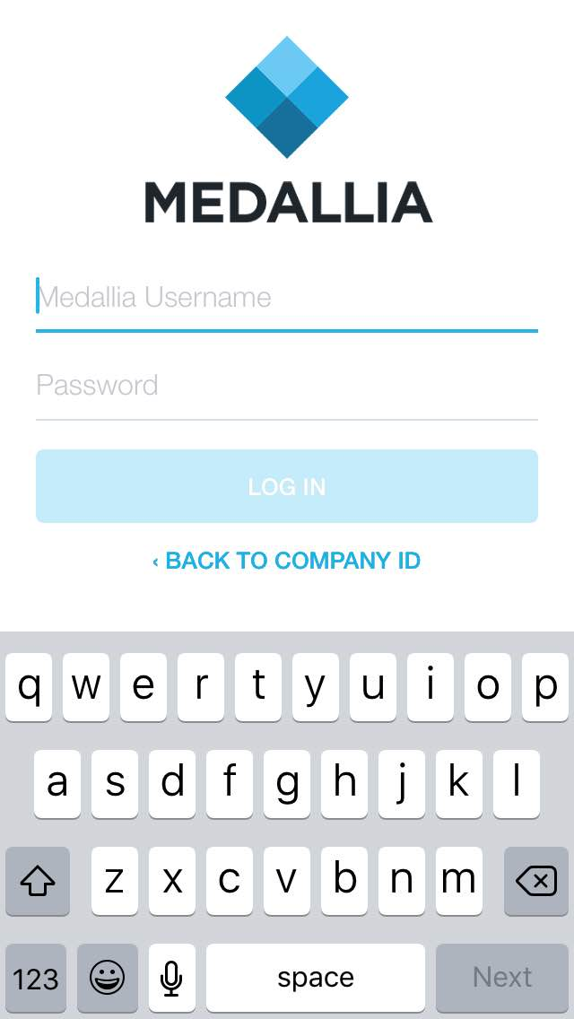
Accessing Medallia Mobile
Instructions
Enter your company ID for the Medallia program
The company ID is: ‘SEBrands’
Enter your username and password

Slide 6
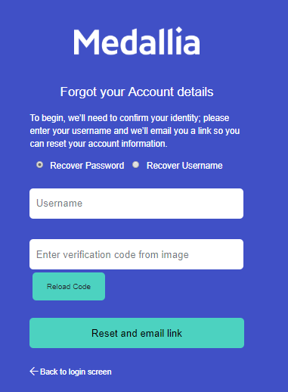
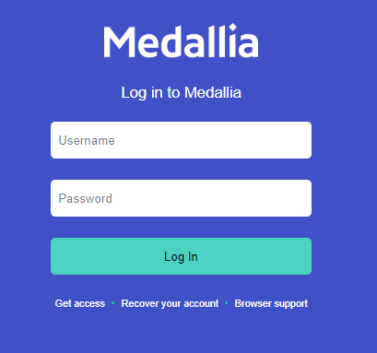
Resetting your Password
Instructions
Select ‘recover your account’ from the log in screen
Select ‘recover password’ and enter your username

Slide 7
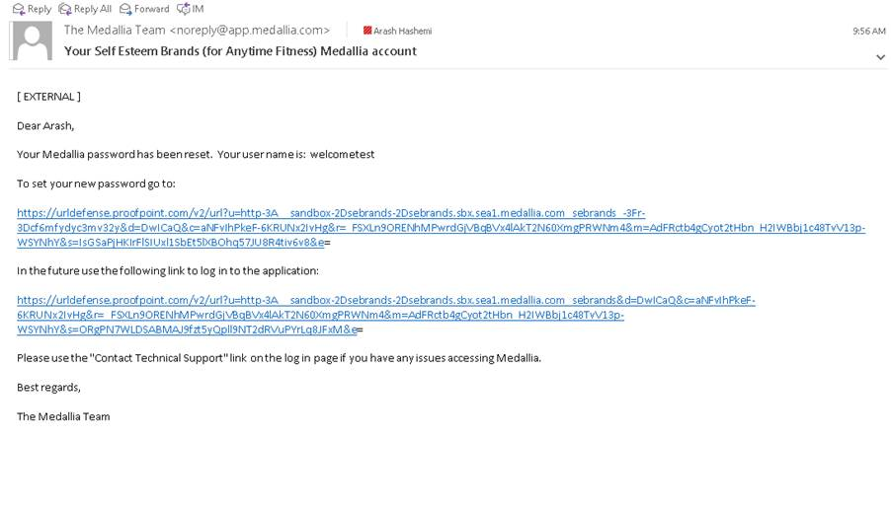
Resetting your Password
Instructions
You will receive an email from the Medallia team – if you don’t receive within minutes, check your spam/junk folders
Follow the prompts to reset your password

