Slide 1
SURVEY INVITATION

Slide 2
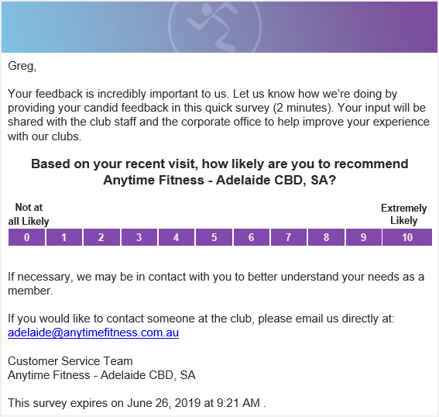
Member Survey Invitation
Details
Members are asked for feedback regarding their home club
The key question is embedded in the survey. Upon answering, are redirected to the full survey
Members cannot reply to the invitation email. Club email is included for direct contact.

Slide 3
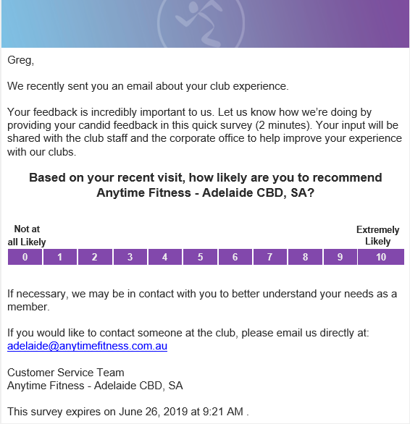
Member Survey Invitation
Details
If a response is not received in 3 days, a member is sent a reminder
All questions and content are the same in the reminder
Survey link remains live for a total of 14 days

Slide 4
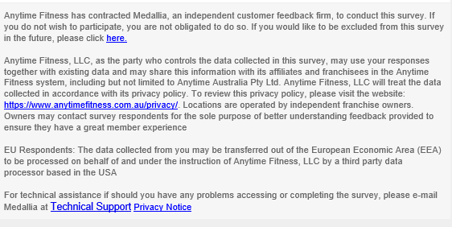
Member Survey Invitation
Terms & Conditions
Members are given the option to opt-out of future surveys
Your country’s AF privacy policy is also included in the terms and conditions
If a member has a technical question or wants to review Medallia’s privacy policy, it is included

