Slide 1
Medallia
Dashboard

Slide 2
Dashboards
Key Metrics at a Glance
Your morning cup of coffee.
The Dashboard is the Medallia landing page for all users. This report is customized by role, and visually displays the most relevant data for a user at a high level.

Slide 3
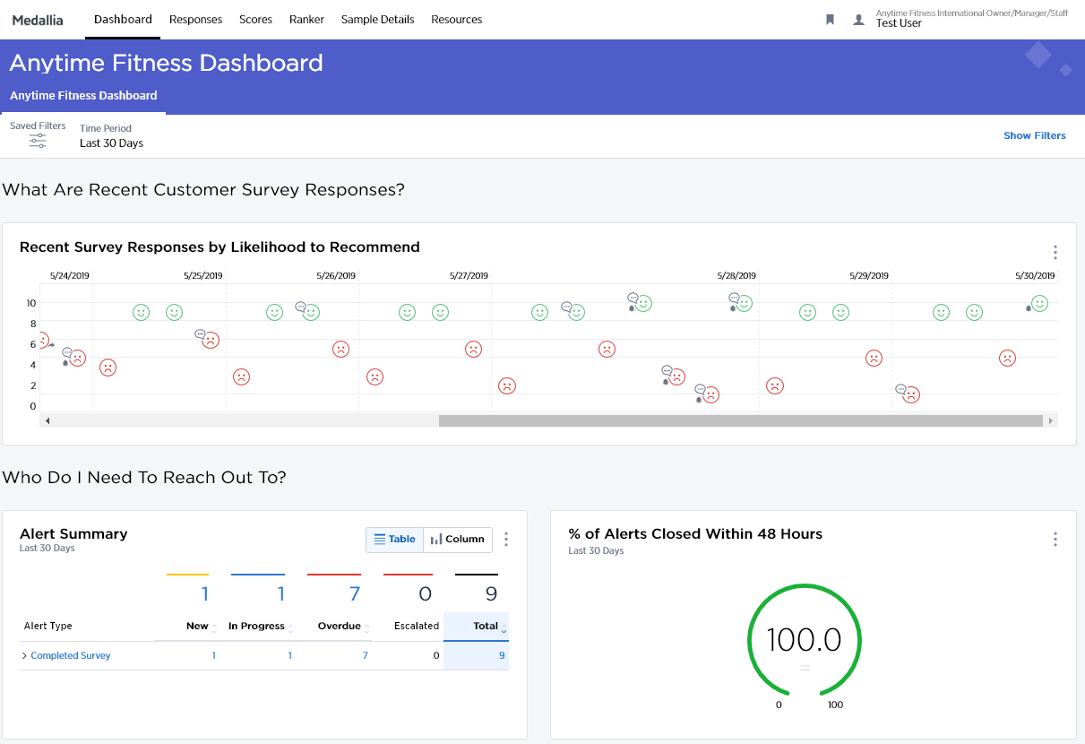
Dashboard
Your Key Metrics At A Glance
Overview dashboards should be thought of as a user’s ‘morning cup of coffee’ - these reports should be quick and easily understood. From this page, users can then dig into data trends (Data Analytics) or more granular responses (Feedback).
Each sub-tab under Dashboards takes users to a secondary dashboard with additional modules (if present).
Dashboard modules respond to the filters at the top of the page. For example, users can view trends for different time periods or segments once they click on “Show Filters.”
The more options icon on a module allows users to export a PDF or image of that module or an Excel table of its data
1
2
1
2
3
3

Slide 4
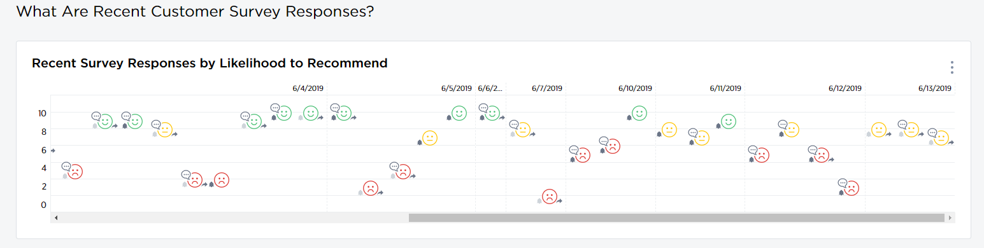
Dashboard
The customer is the most important and central part to the success of this program, so the first widget on the dashboard are the actual customer responses. This shows customer sentiment and scores of each response and allows the user to quickly drill into the responses and follow-up with the customer.

Slide 5
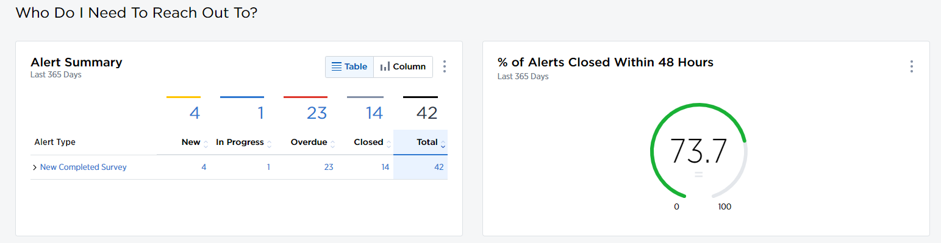
Dashboard
Closing the loop on responses is a priority, so the next item on the dashboard is the rate in which the front line is closing out alerts. The goal is to be at 100% closed alerts within 48 hours.

Slide 6
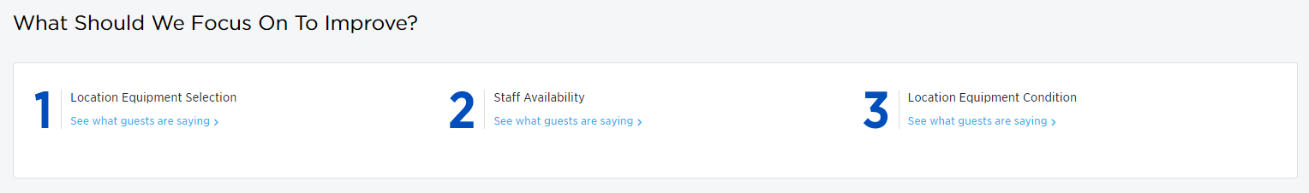
Dashboard
The next section down on the page uses an algorithm to display the top areas that a club can focus on that will have the greatest impact on their score. This is a quick and easy way for clubs to prioritize their improvements and see it impact their key metrics.

Slide 7
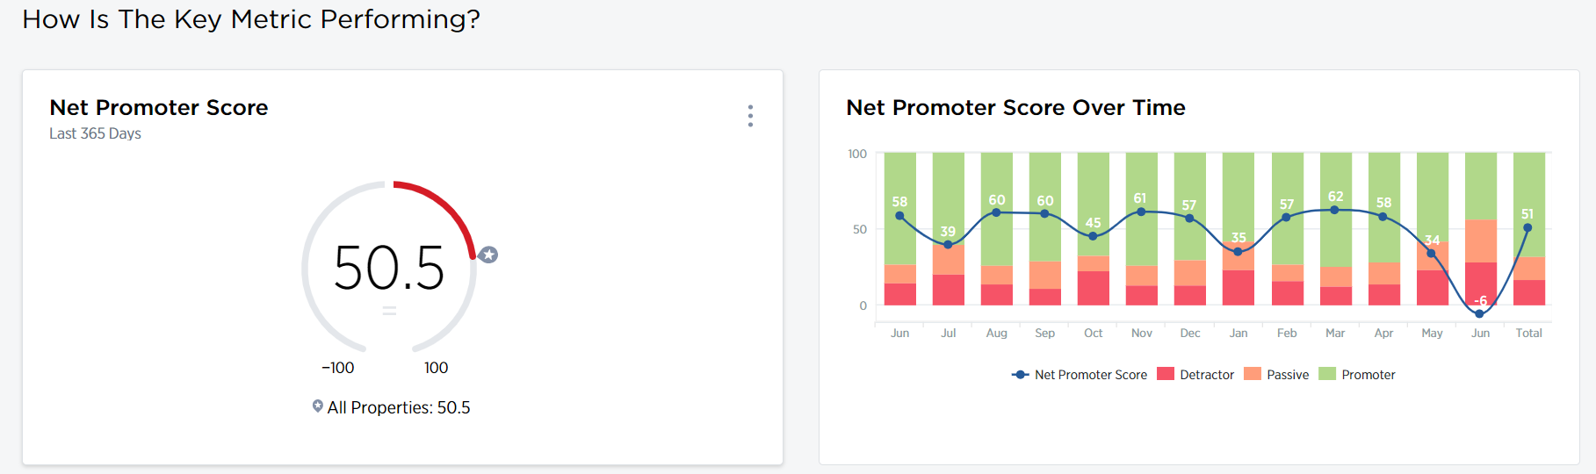
Dashboard
Finally, we have reached the key metric of program. This is how we gauge the overall picture of the customer experience. Below is the Net Promoter Score, measuring the customer’s likelihood to recommend the location to other people.

Slide 8
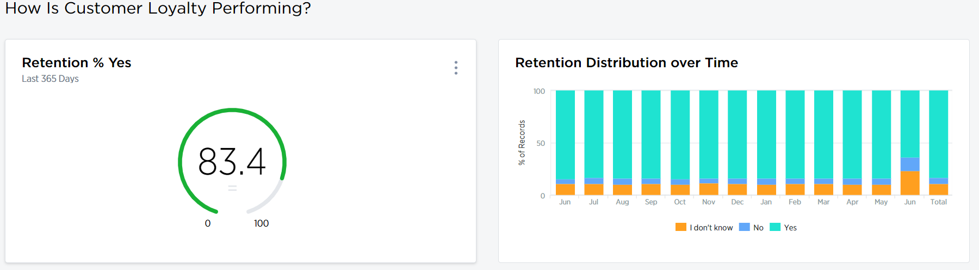
Dashboard
The next section measured the customers’ self reported likelihood to continue their relationship with the location.

Slide 9
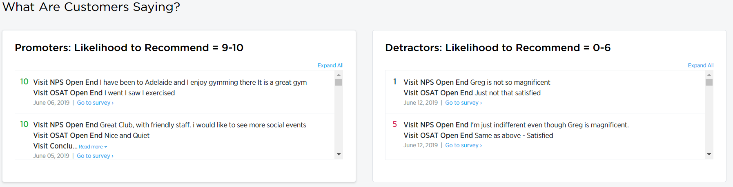
Dashboard
Then, we have a snapshot of the positive and negative comments. This can be used to quickly look at any glaring issues and resolve them quickly (i.e. the a/c wasn’t working, the gym was dirty, etc.)

Slide 10
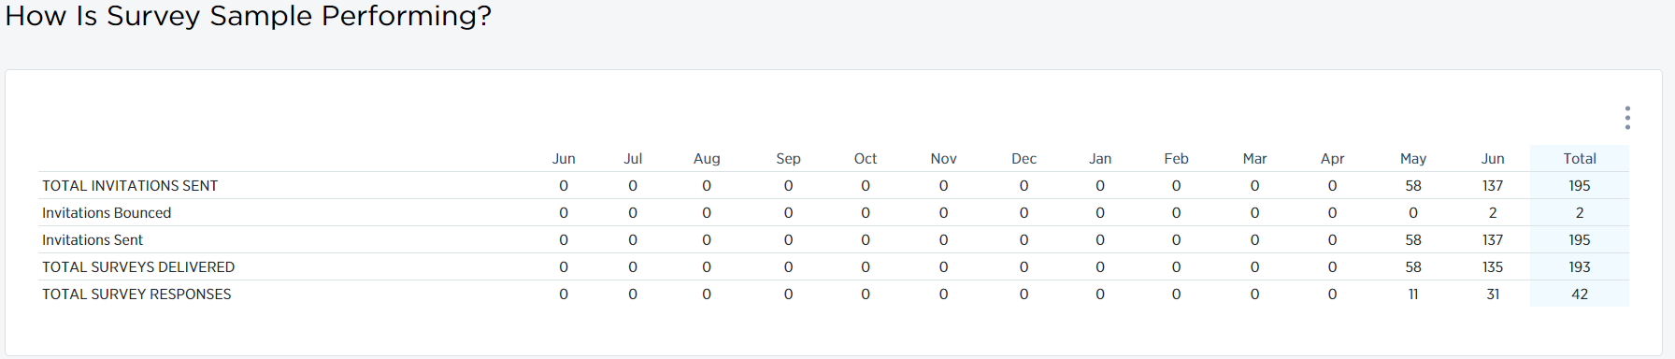
Dashboard
Finally, the bottom widget just shows how the survey itself is performing. This shows how many were sent out and take rate.

Slide 11
TIME TO
RELAX
Notes:
With countdown timer

