Slide 1
Medallia
Reporting Tabs

Slide 2
Responses
Completed Surveys
View individual survey responses.
The Feedback tab allows users to see all incoming survey responses. Users can view all surveys in an inbox view, as well as dig into individual surveys.

Slide 3
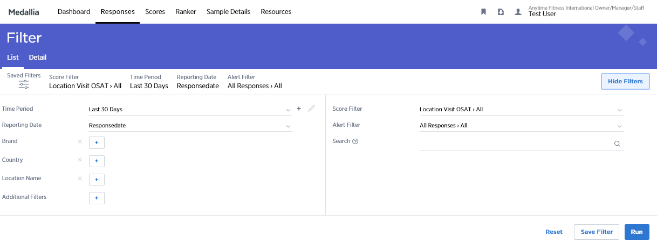
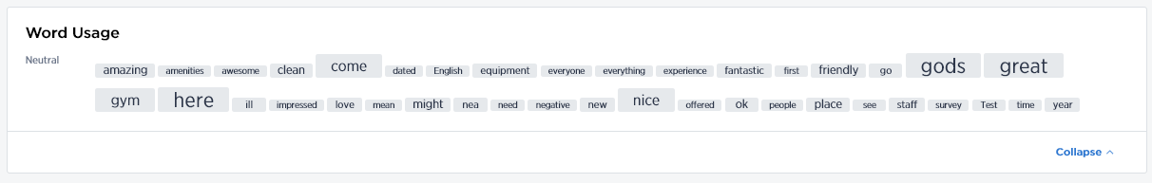
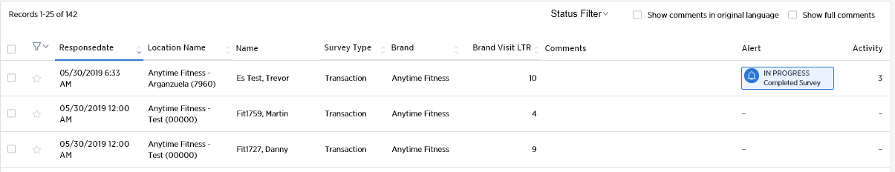
Responses: List
View Incoming Survey Responses
1
There are two default tabs in the responses view - List and Detail. The List view, which is pictured here, shows all survey responses in the format of an email inbox.
There are additional Filters on the Feedback List Tab (score, alert, search, etc...). Here users can slice and dice data in various ways to find responses that match any given criteria.
The Word Usage cloud displays common terms from survey responses. The size indicates the relative frequency and the coloring indicates whether the average main score for surveys with that word is below or above the relative average. The cloud will change depending on the filters selected.
These rows represent individual survey responses. Each column contains data associated with the survey response. There are blank stars on the far left. These stars enable users to mark individual surveys with color codes. Each color code is a note that is unique to each user!
1
2
2
3
3
4
4

Slide 4
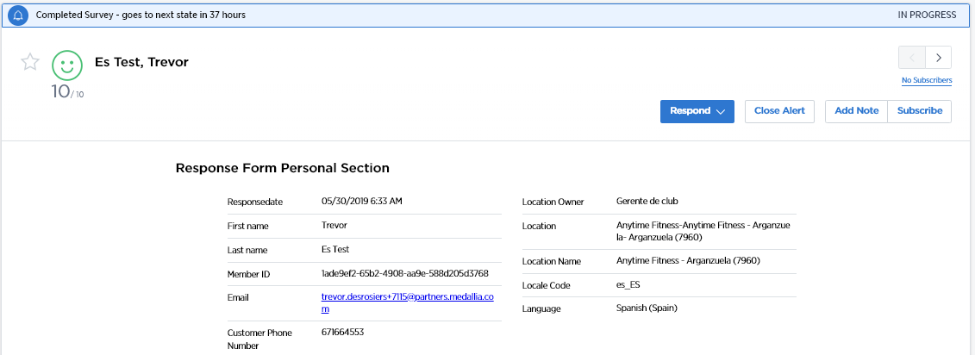
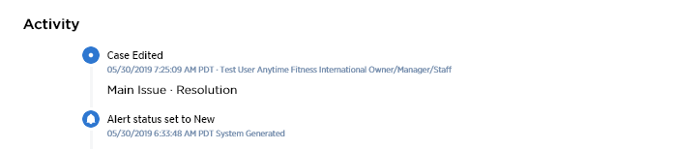
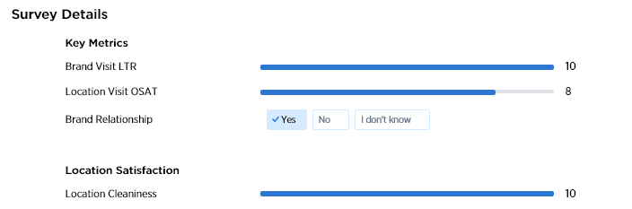
Responses: Detail
View Individual Survey Responses
1
There are two default tabs in the responses view - Filter and Form. The Form view, pictured here, shows an individual survey response, mimicking a survey form.
Top Banner: This top banner indicates that this survey has triggered an alert. The banner also provides information about the alert. If no alert has been triggered, this banner will not be present. If an alert has been closed, this banner will be grey.
The Responses Form is also where users will close the loop with customers. Buttons for Closing the Alert and Assigning Alert ownership may be relevant. The Add Note feature adds context in the Activity Log. More detail on this functionality can be found in the Closed Loop section of this guide.
The top of the tab shows important customer information regarding both the customer and the interaction. Users can use this tab when preparing to close the loop with a customer.
The Activity Log can be expanded to show all activity related to this survey.
The majority of the page shows a customer’s survey responses.
2
3
1
2
4
3
5
4
5

Slide 5
Scores
Analyze Scale Metrics
Scores allows users to view aggregate scores for all scale questions in the survey programs. These results can be benchmarked, sliced and diced by customer segments, and calculated in different ways.

Slide 6
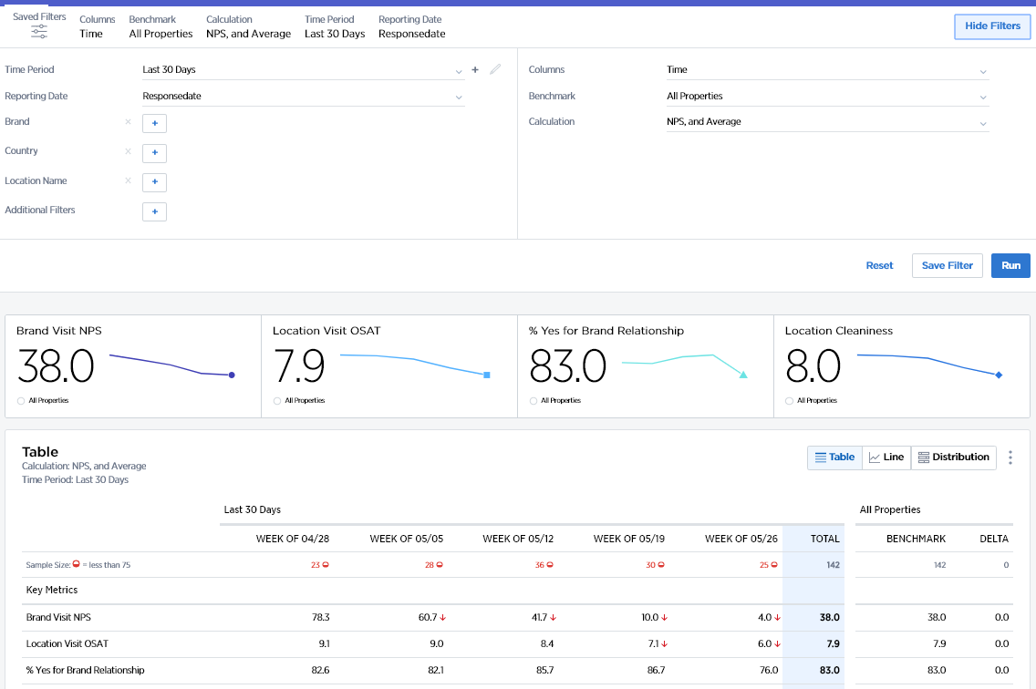
Scores: Table
Analyze Scale Metrics
1
Satisfaction Table displays all of the scale questions in a table view. This allows users to slice and dice survey scores with the available filters.
Additional Filters on the Table view:
Benchmark: Compare against different time periods or benchmark groups
Columns: Compare scores across segments instead of over time
Calculation: Change the calculation being used for the displayed metrics
Users should “Reset” the filters when they want to clear data and “Run” the filters when they want to see the results for the filters they have selected.
The sample size is displayed across the top.
Note! The benchmark column will not always apply.
1
2
2
3
3

Slide 7
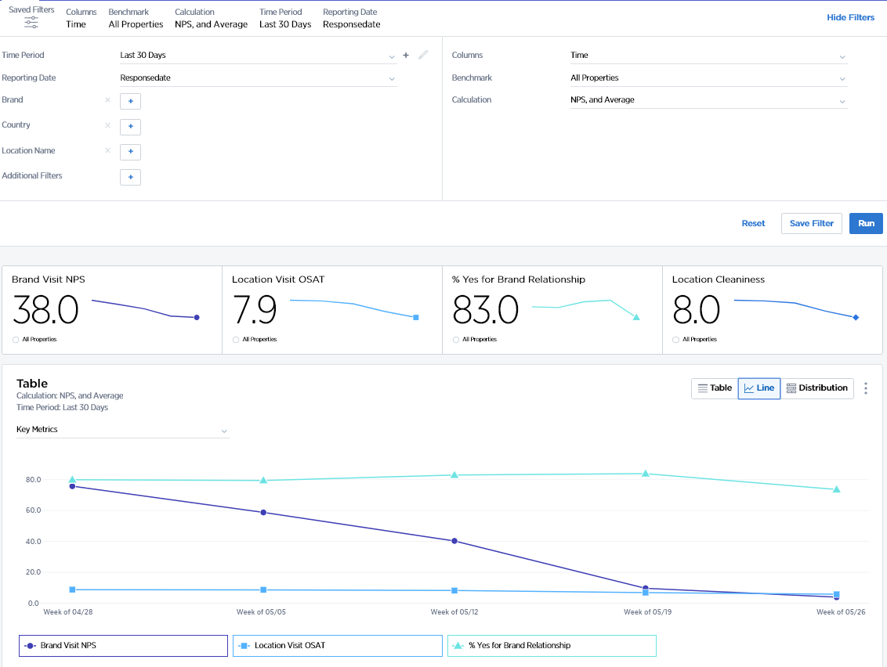
Scores: Line
Analyze Scale Metrics
Satisfaction Line displays all of the scale questions in a line graph view, allowing users to view scores over time.
Users should “Reset” the filters when they want to clear data and “Run” the filters when they want to see the results for the filters they have selected.
Select which group of scale questions to display on the graph
Note! Line graphs are interactive. If you click on a label, the line will disappear, and if you click on the label again, then the line will come back.
1
1
2
2

Slide 8
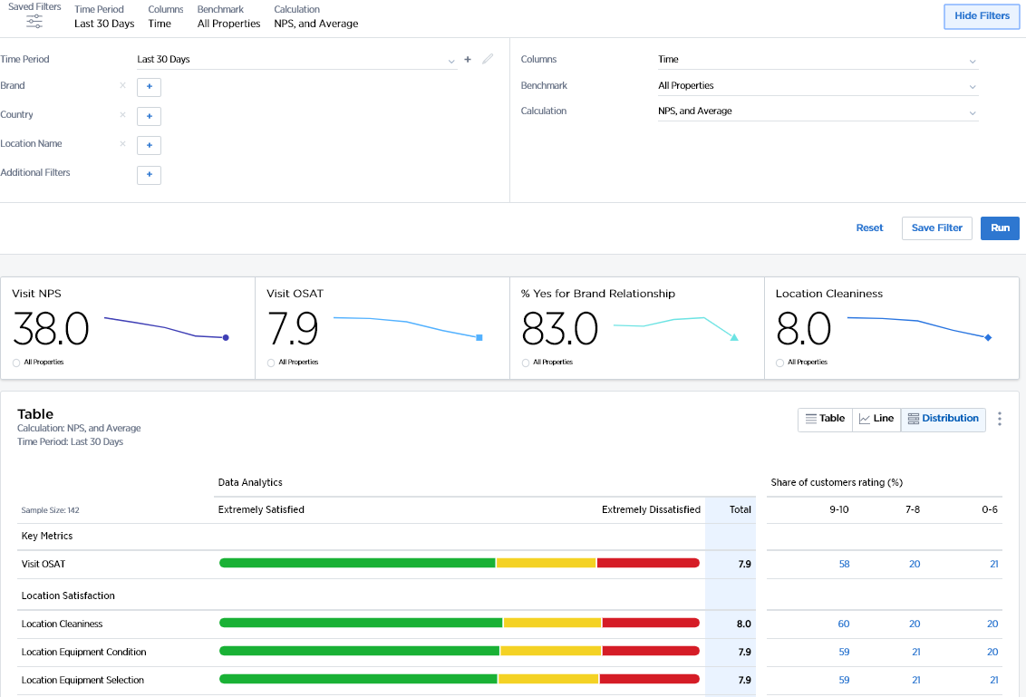
Scores: Distribution
Analyze Scale Metrics
Satisfaction Distribution displays all of the scale questions showing their score ranges graphically.
Users should “Reset” the filters when they want to clear data and “Run” the filters when they want to see the results for the filters they have selected.
Users can see the percentage of surveys in each score segment and click on the number to see the individual responses.
The graphs are color coded (Red = Detractor to Green = Promoter) and the “Total” Column represents the score calculated from the Calculation Filter.
1
1
2
3
3
2

Slide 9
Ranker
Rank Segments and/or Levels within the Organization
Ranker allows users to rank levels and segments within the organization across the different survey metrics.
This report often reveals key coaching/pairing opportunities within a team or department.

Slide 10
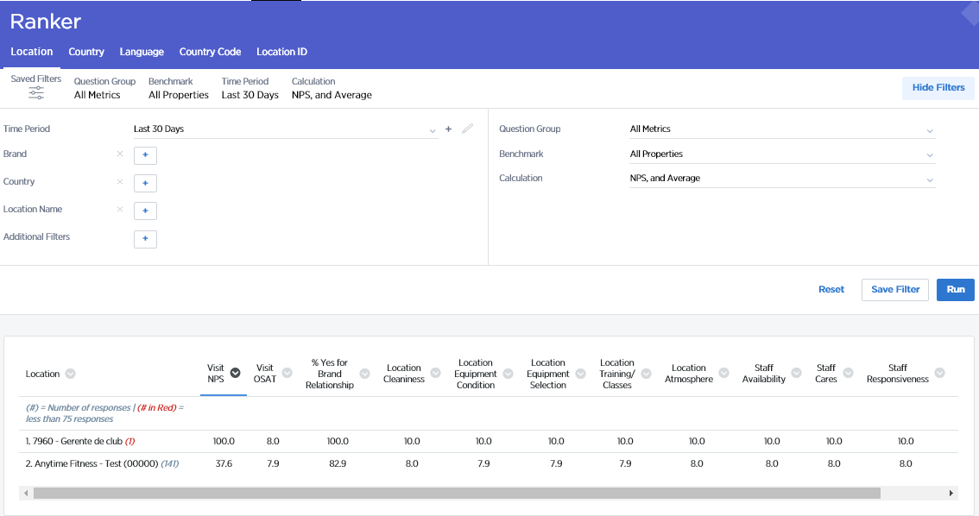
Ranker
Rank Segments and/or Levels
1
1
The subtabs on the ranker tab determine what group or segment is being ranked.
Filtering is available based on hierarchy information or segmentation. Users can filter data to one segment value or filter across a range of segments and values.
Questions, Benchmarks and Calculations allow users to change what they are viewing on Ranker.
Questions: See how different groups and segments rank based on a particular question or question group.
Benchmarks: Compare against different time periods or groups
Calculations: Change the calculation being used for the displayed metrics
2
3
2
3

Slide 11
Sample Details
Analyze Non-Scale Metrics and Client Demographics
Sample Details allows users to view demographics and segments of survey takers, revealing the percentage or number of survey takers within each grouping.

Slide 12
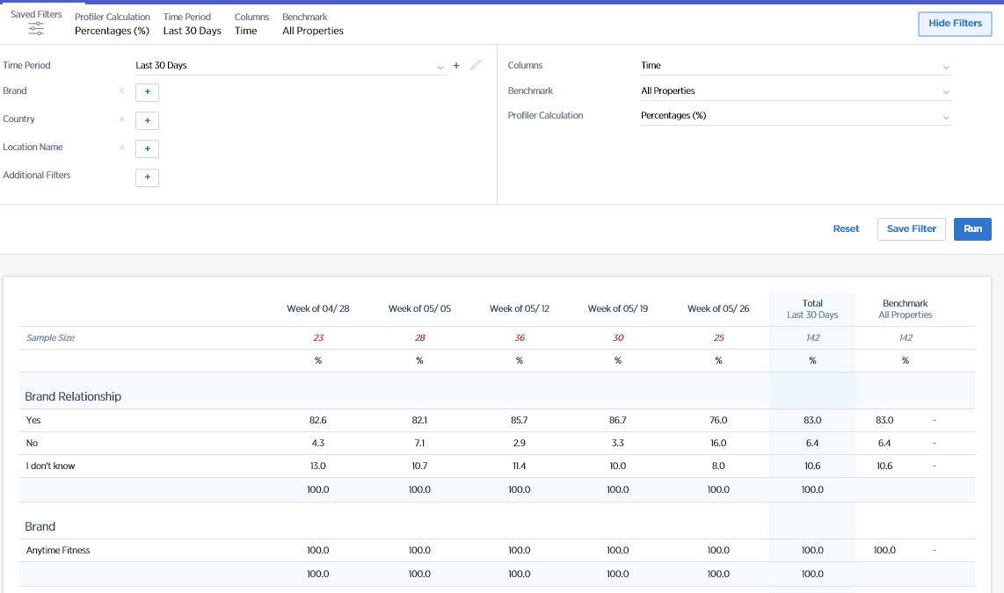
Sample Details: Table
Analyze Non-Scale Metrics and Client Demographics
1
1
Additional Filters on the Sample Details Table view:
Columns: Compare scores across segments instead of over time.
Benchmark: Compare against different time periods or groups.
Calculation: Change the calculation being used from percentage of responses within each value to count of responses within each.
Sample Details displays a demographic or segment breakdown of completed surveys by percentage or by count.
The difference column displays the difference between the total and the selected benchmark.
3
2
2
3

Slide 13
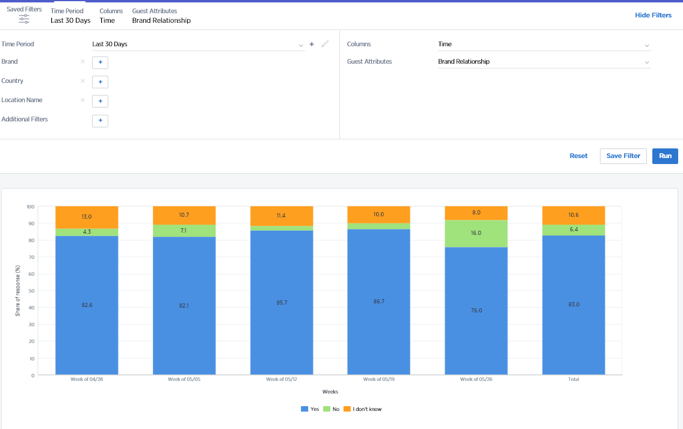
Sample Details: Graph
Analyze Non-Scale Metrics and Client Demographics
1
Sample Details Graph displays customer segmentation data as well as non-scale questions in segmented graph form. The bars are broken out into the percent respondents from the total number of respondents.
Users can use the Columns dropdown to determine what is shown on the X-axis.
Users can select a segmentation grouping to inspect (in the example to the left, it will be ‘line of business’) in the Guest Attributes dropdown.
The legend will display the option sets within the selected segmentation grouping.
2
1
2
3
3

Slide 14
Resources
Find Documentation
The Documents Tab is a repository for training materials and informational decks that will help end users understand the program, the metrics, and the process. Client teams send these materials to their Medallia team to maintain on the Documents tab. Medallia does not provide Its own content, as this information is customized by our clients for their users.
The content of this tab differs program by program but can include the following:
Client Customized User Guide
Quick Reference Guides
Reusable Survey Links
FAQs
Other Materials developed by Client Training Team

Slide 15
TIME TO
RELAX
Notes:
With countdown timer

