Slide 1
Medallia
Basic Navigation

Slide 2
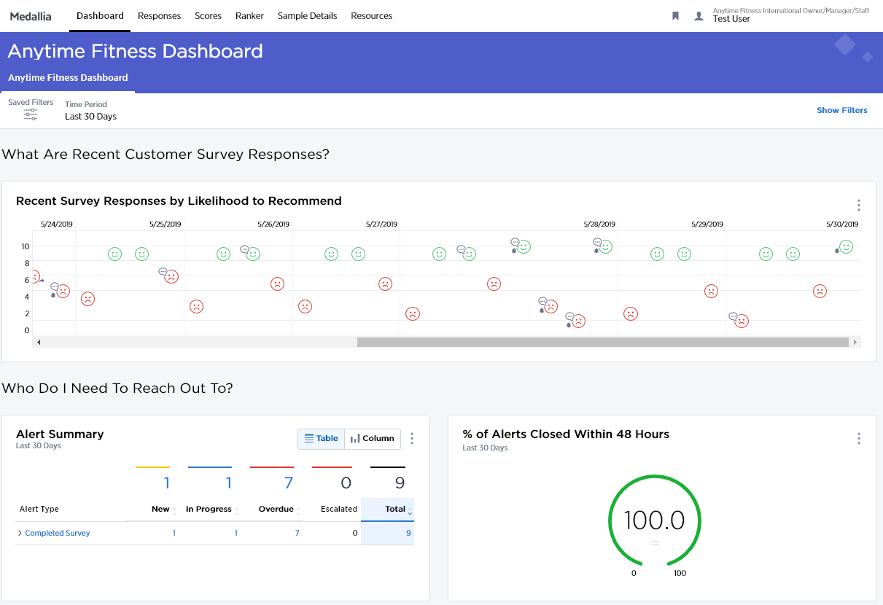
The Medallia Dashboard
1
From the Dashboard a user should dive into other reports in the system. By clicking on the other tabs in this top navigation bar they can dig deeper into the data. These high level tabs often include:
Responses: Where users will see individual survey responses.
Scores: Where users can investigate trends and view scores across demographic segments.
Ranker: Where users can rank levels and segments of the organization on key metrics.
Sample Details: Where users can see segments and demographics of survey takers.
Resources: Where users can see a library of information related to customer experience and Medallia.
1

Slide 3
Filters
Segmentation at Your Fingertips
Slice and dice the data.
Filters are available throughout the Medallia system. These allow for quick segmentation analysis on customer data.

Slide 4
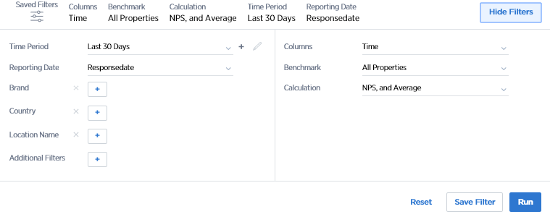
Filters
Segmentation at Your Fingertips
1
Filters allow users to slice and dice data. By choosing the segments that they are interested in, users can cut the data and view scores for different customer segments.
The filters are found at the top of each report or tab. On the Dashboard tab there may be a button that says “Show Filters” or “Hide Filters.”
1

Slide 5
Filters
Where They Are and How to Use Them
1
Filters, located at the top of each tab, allow users to display results for a specific subset of data.
Filters vary from tab to tab. Some are available on all pages, while others are specific to a single tab.
Filters are dynamic. This means that values which are not within the selected filters will not show.
Click “Run” to apply the filters to the page.
Click “Reset” to reset the filters to default. Note that often users forget to clear the filter settings! Remember to hit reset!
1
2
2

Slide 6
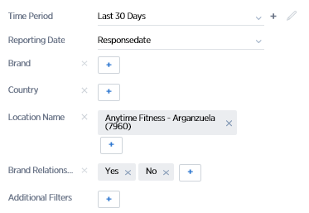
Filters
Selecting the Right Data
1
1
Multiple filters can be selected at the same time. This means users can select filters both within a filter category and across different categories.
When selecting across filters the system uses an AND operator. That means Medallia only selects data that belongs to the combination of filters selected.
Within a category, the system uses an OR operator. This means that Medallia selects data that belongs to either of the different values selected.
Note! Filters will persist across tabs, meaning switching from tab to tab retains a user’s filter settings. Medallia can configure this differently for Dashboards, depending on your program needs.
2
2

Slide 7
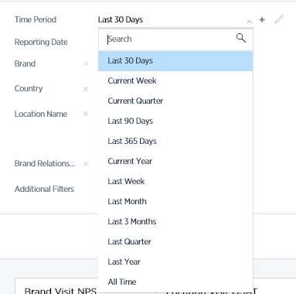
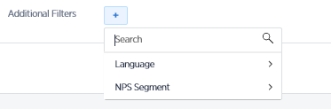
Filters
Filter by Time Period and by Customer Segment
1
1
The Time Period Filter allow users to select from a variety of predefined time periods. It also allow users to create their own custom time period. To create a custom time period, users can click on the + icon and enter the desired date ranges in the pop-up window. This time period can now be accessed in the dropdown at any time. To modify a custom time period, users can hover on the time period and click the small pencil icon.
The “Additional Filters” menu contains a list of segments and questions that can be used to slice and dice the data.
2
2

Slide 8
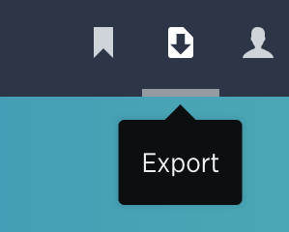
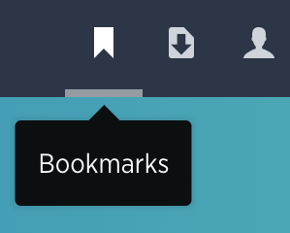
Common Icons
Print/Export and Bookmark
1
Users can click here to print or export the information on a given tab.
To use this feature, users must first run the report they would like to download. After clicking, users will be shown a dropdown - print will navigate to the print screen. PDF and Export will download to the computer.
This export functionality is available for Responses, Satisfaction, and Ranker. Exported data is associated with the Filters selected (more info on filters later in the guide).
Users can click here to bookmark a page (save the view with specific filters) and to load, rename, or delete a previously saved bookmark.
Once a user clicks the Bookmarks icon and selects “Bookmark this Page” they can enter a name for the report in the highlighted area and click “Save.” This will be added to the bookmarks list.
1
2
2

Slide 9
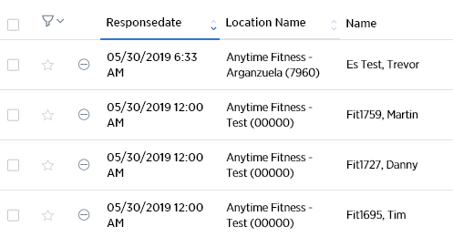
Sorting
Using the Arrows
1
Data on the Medallia system is sortable through one easy arrow icon on the interface. Once users have filtered data, they can sort it by clicking this icon.
1

Slide 10
TIME TO
RELAX
Notes:
With countdown timer

