Slide 1
Medallia
Closing the Loop

Slide 2
Closing the Loop
Why It Matters?
Our customer is at the core of our business and we owe it to them to listen and respond to their thoughts, concerns, and ideas.

Slide 3
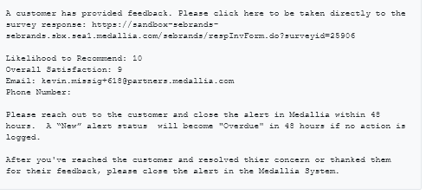
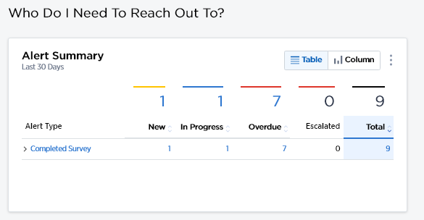
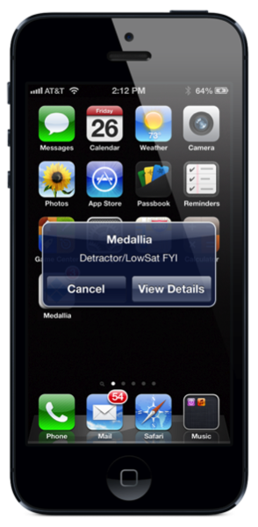
Closing the Loop
Triggering Alerts
1
When a survey response is received by Medallia the system will generate an email alert notification.
Users are notified about this alert in different ways:
The Club Email
The Medallia Dashboard
Push Notifications via the Mobile App (if set up by the user)
1
2
2
3
3

Slide 4
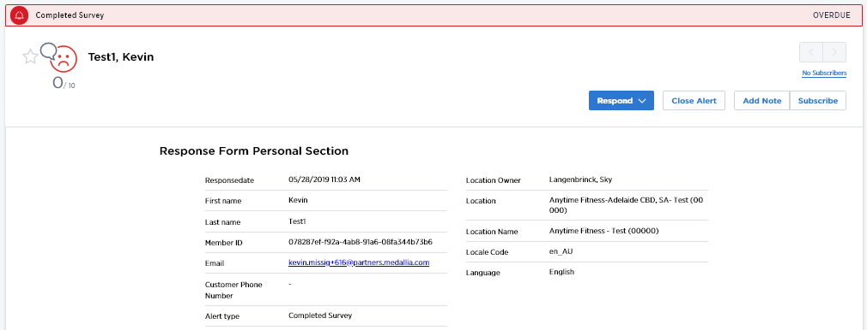
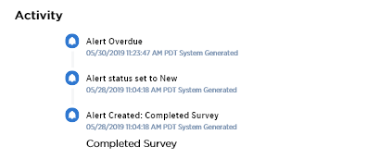
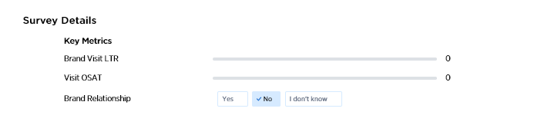
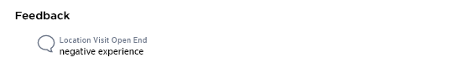
Closing the Loop: Responding (Step 1)
Review Response
Before reaching out to a customer, users need to know everything they can about that customer’s experience. This means that they should review the Medallia survey response, background information and in some cases contact other employees that may have further context about that customer’s experience.
Scroll functionality allows users to navigate through individual feedback records with the back and forth arrows. If a user has pre-sorted on a list of customer responses in the filter view, this will help them move through those responses quickly!
The Responses Detail form houses customer data which will enable users to be better informed when they follow up with a customer.
The Activity Log enables users to review what has occurred regarding the alert. They will be able to see comments, emails, and other notes that users have added regarding this customer’s experience.
1
2
1
3
2
3

Slide 5
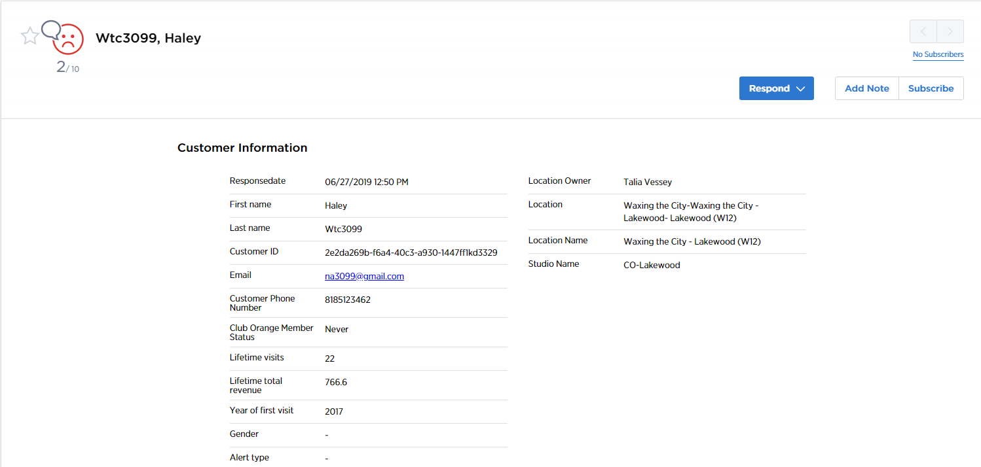
Closing the Loop: Responding (Step 2)
Contact the Customer
1
2
The Respond functionality allows for email follow-up in the following manner:
Rapid Response Email templates - here you will find pre-made emails to reach out to a customer which saves time!
Different Types of Templates can be used (Thank you’s, Apologies, etc)
Any email correspondence is tracked in the “Activity” portion of the window.
The Add Note functionality allows users to leave a note. Sometimes users will not be able to reach a customer on a first attempt - this is the perfect place to record that attempt. Notes added here are kept in the Activity Log so that other users know that this user is in progress of speaking to someone at Medallia.
1
2

Slide 6
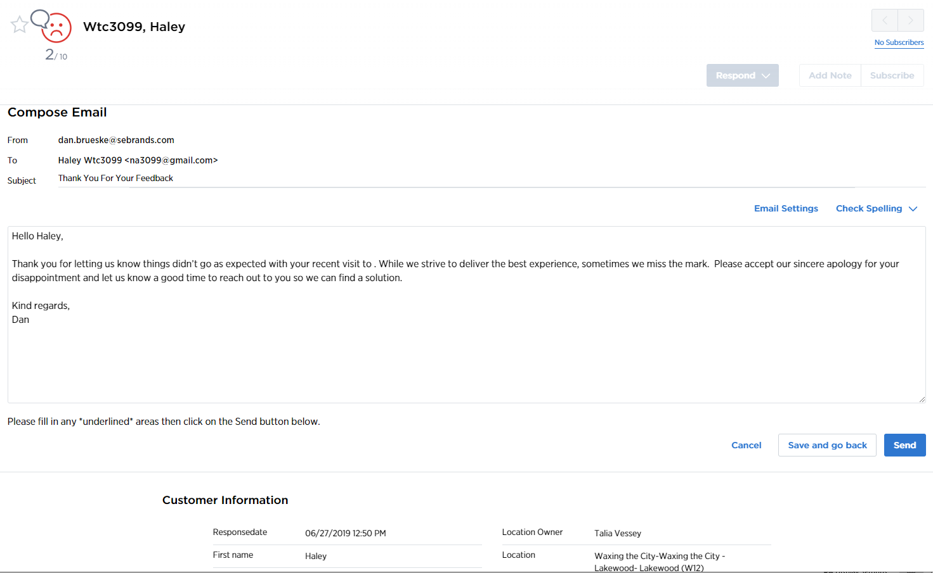
Closing the Loop: Rapid Response
Example Template
1
The subject line is pre-populated by Medallia, however, users may update this subject line so that it speaks more personally to the customer.
The Email Settings button allows users to modify their Signature, which includes their name, email address, phone number, and other contact information.
Personalize the email response here. Underscores in the body text, example _________[insert theme]________, must be modified in order for a user to send the email. The screen will not allow an email to be sent if an underscored portion is not edited.
These buttons work similarly to a user’s normal email, allowing them to save and go back, discard the draft, or send the email from this screen.
The full feedback detail is available below, providing more situational context for the customer’s interaction.
1
2
2
3
3
4
5
4
5

Slide 7
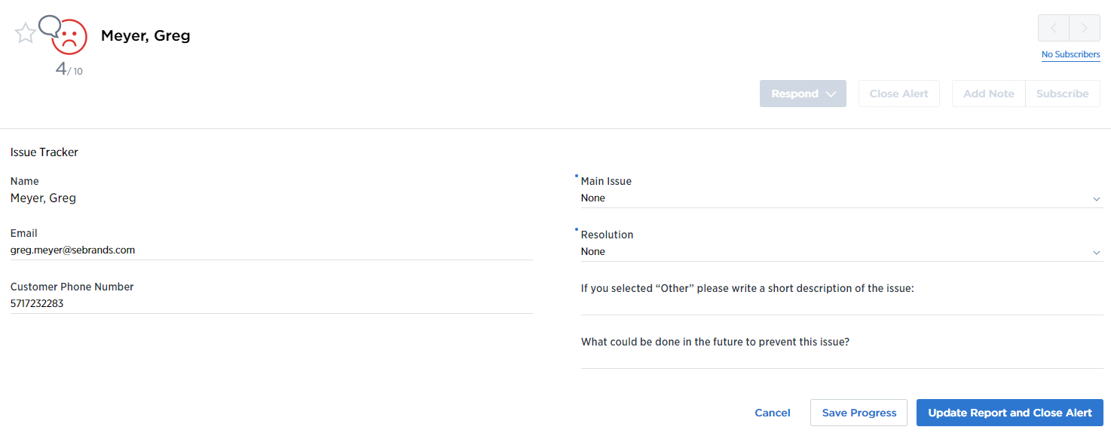
Closing the Loop: Root Causes
Aggregate Insights Across the Company
The Alert Close form is where users will complete the closed loop with a customer! This information can be used by an organization to gather insights which will provide customers with better experiences. An organization can choose whether this report is required to close an alert or available for all surveys at all times.
Some of the fields are required, such as the Main Issue and Resolution. These required fields help for segmentation purposes, but do not provide the detail that comments do.
Users should fill out the comments! This way the organization will be able to address an individual customer’s needs in future communication.
Updating the form will save a user’s input. When this form is required for alerts there will be two buttons - one to save only, and one to save and close the alert.
1
2
1
3
2
3

Slide 8
TIME TO
RELAX
Notes:
With countdown timer

