Slide 1
MEDALLIA APP

Slide 2
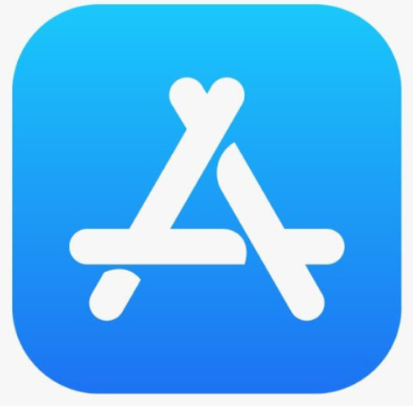
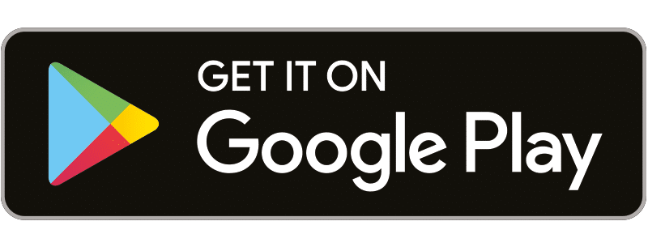

Accessing Medallia Mobile
Instructions
Download the app from the App Store or Google Play Store
Select the Medallia 3.0 Mobile App
There may be other Medallia Apps in the app store, only select the Medallia 3.0 Mobile App
OR

Slide 3
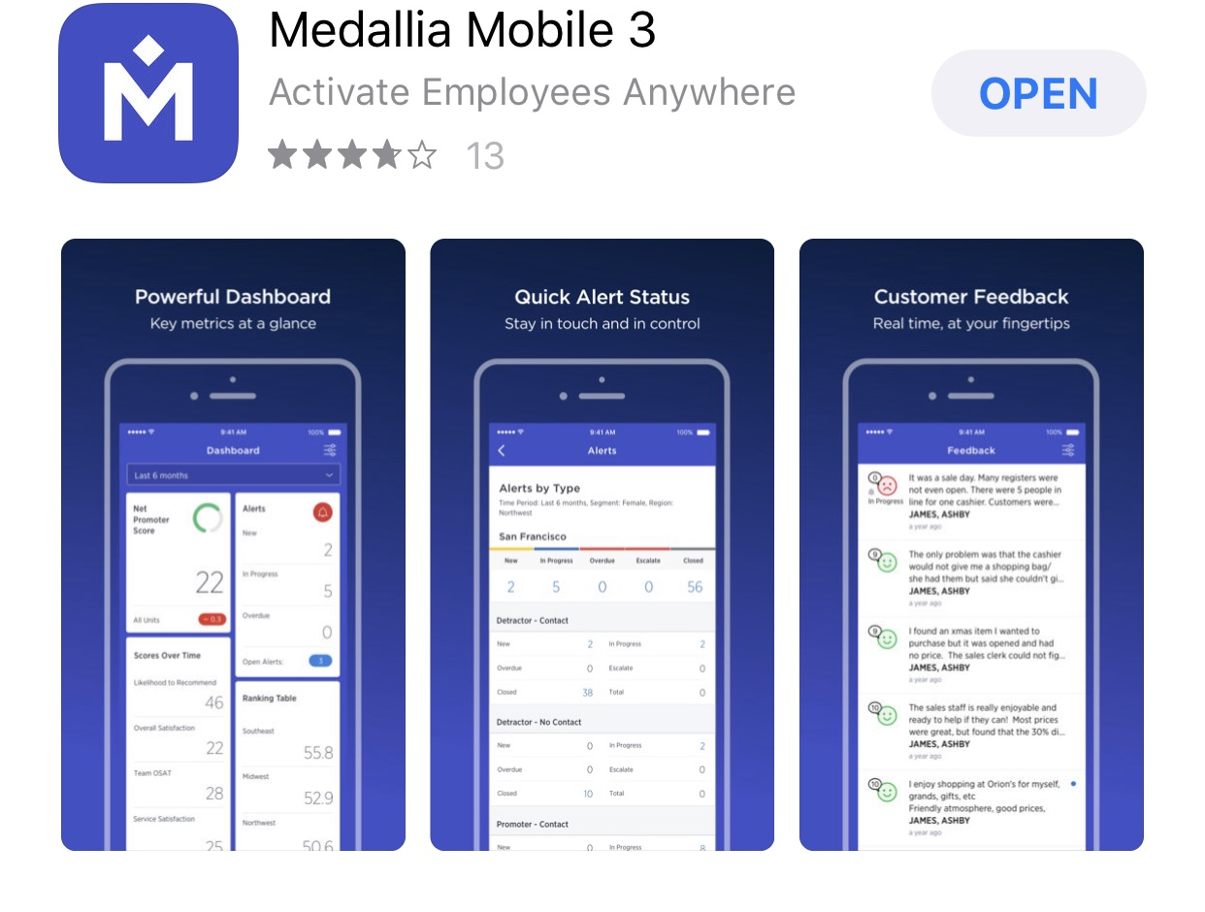
Medallia Mobile Download
Instructions
Medallia has various apps in the app store so ensure you are downloading the correct app and the correct version

Slide 4
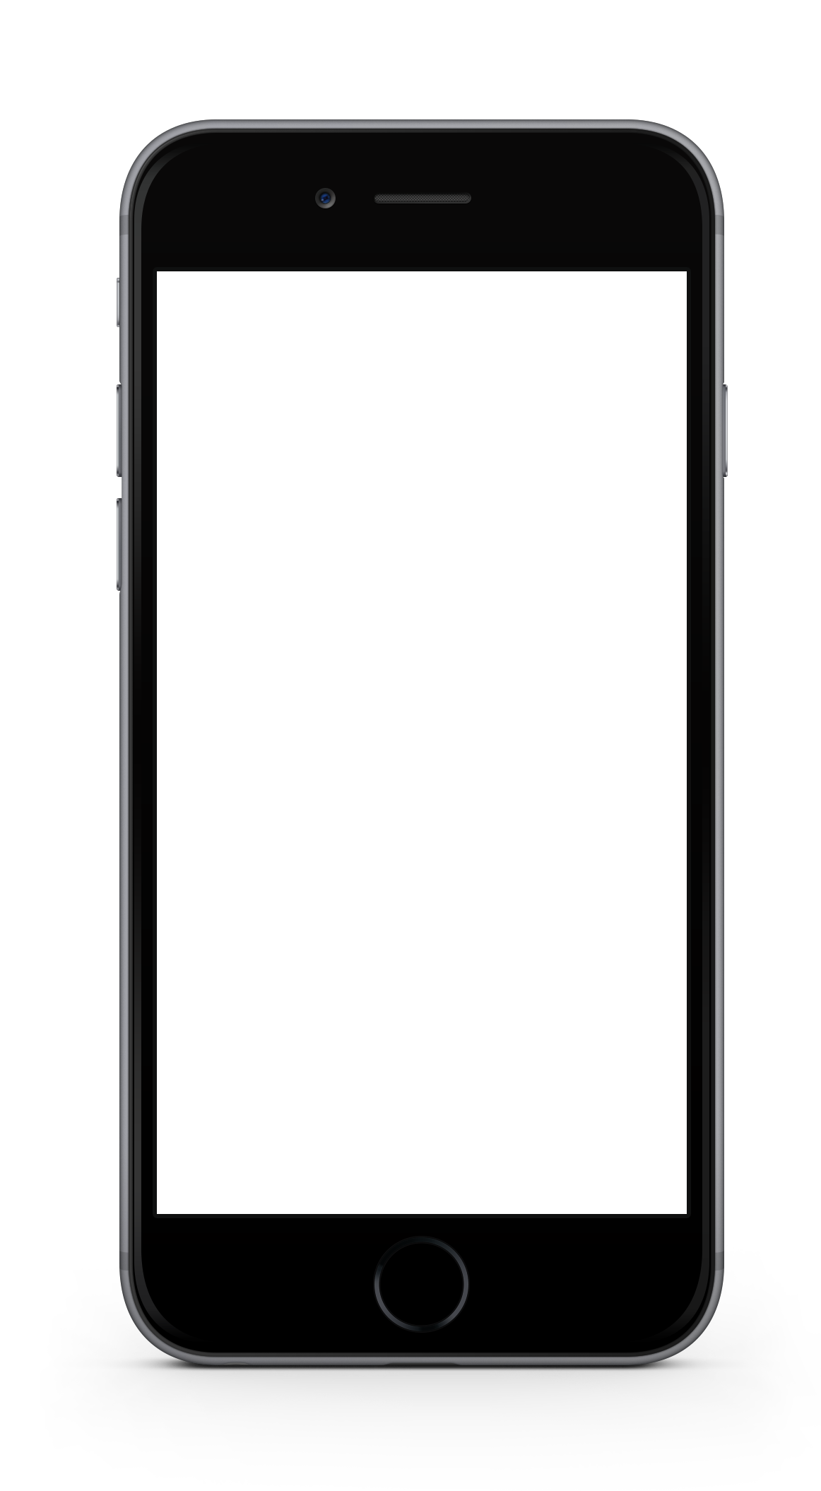
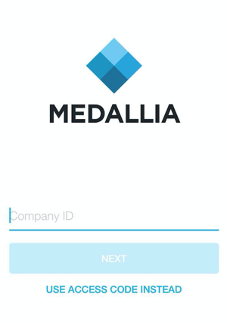
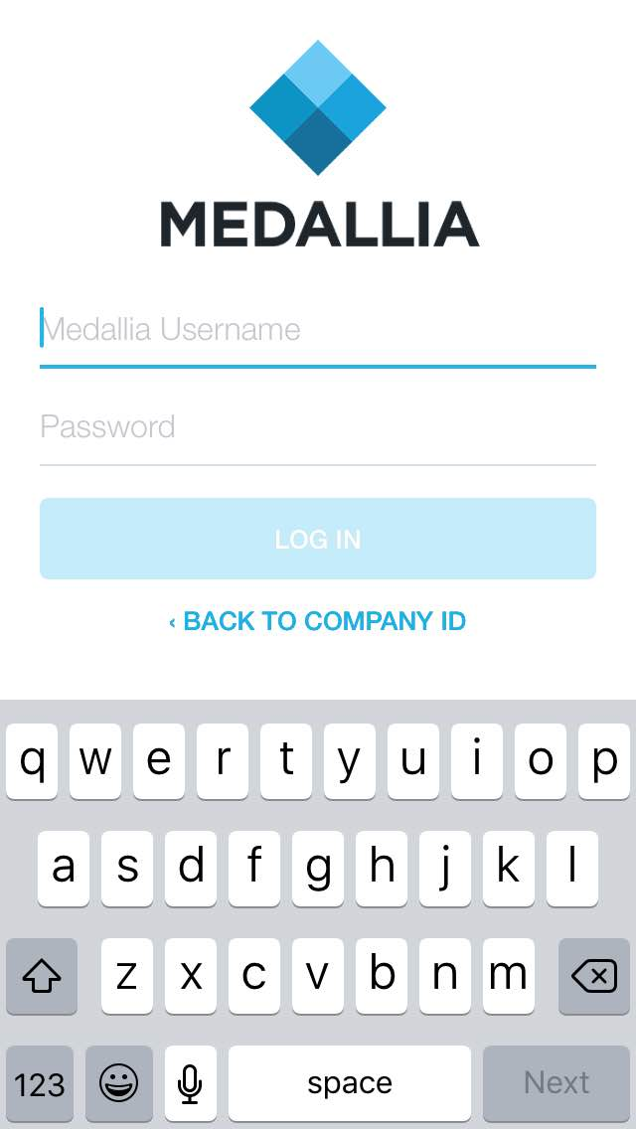
Medallia Mobile Login
Instructions
Enter your company ID for the Medallia program
The company ID is: ‘SEBrands’
Enter your username and password

Slide 5
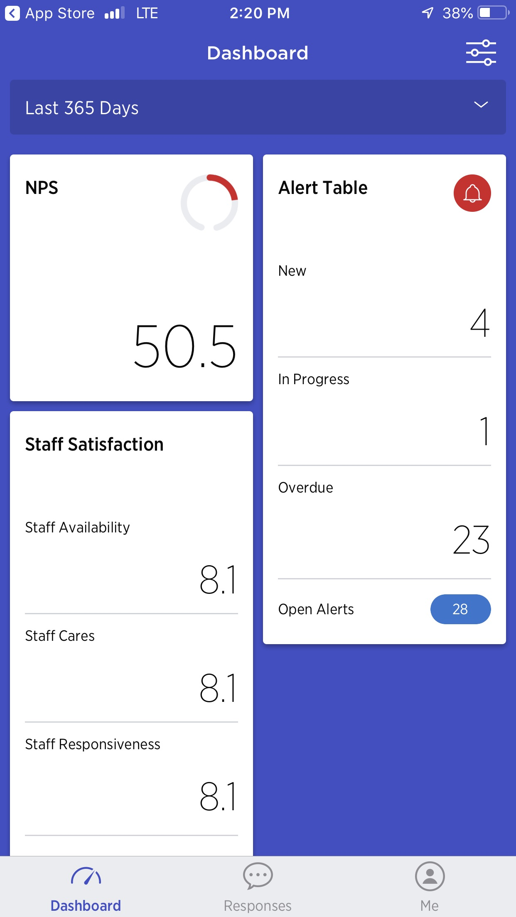
Medallia Mobile Dashboard
Instructions
Upon entering the app you will land on the dashboard which includes key metric score, staff measures and performance on closing the loop.
Each widget in the dashboard is clickable and allows for drill down capabilities.

Slide 6
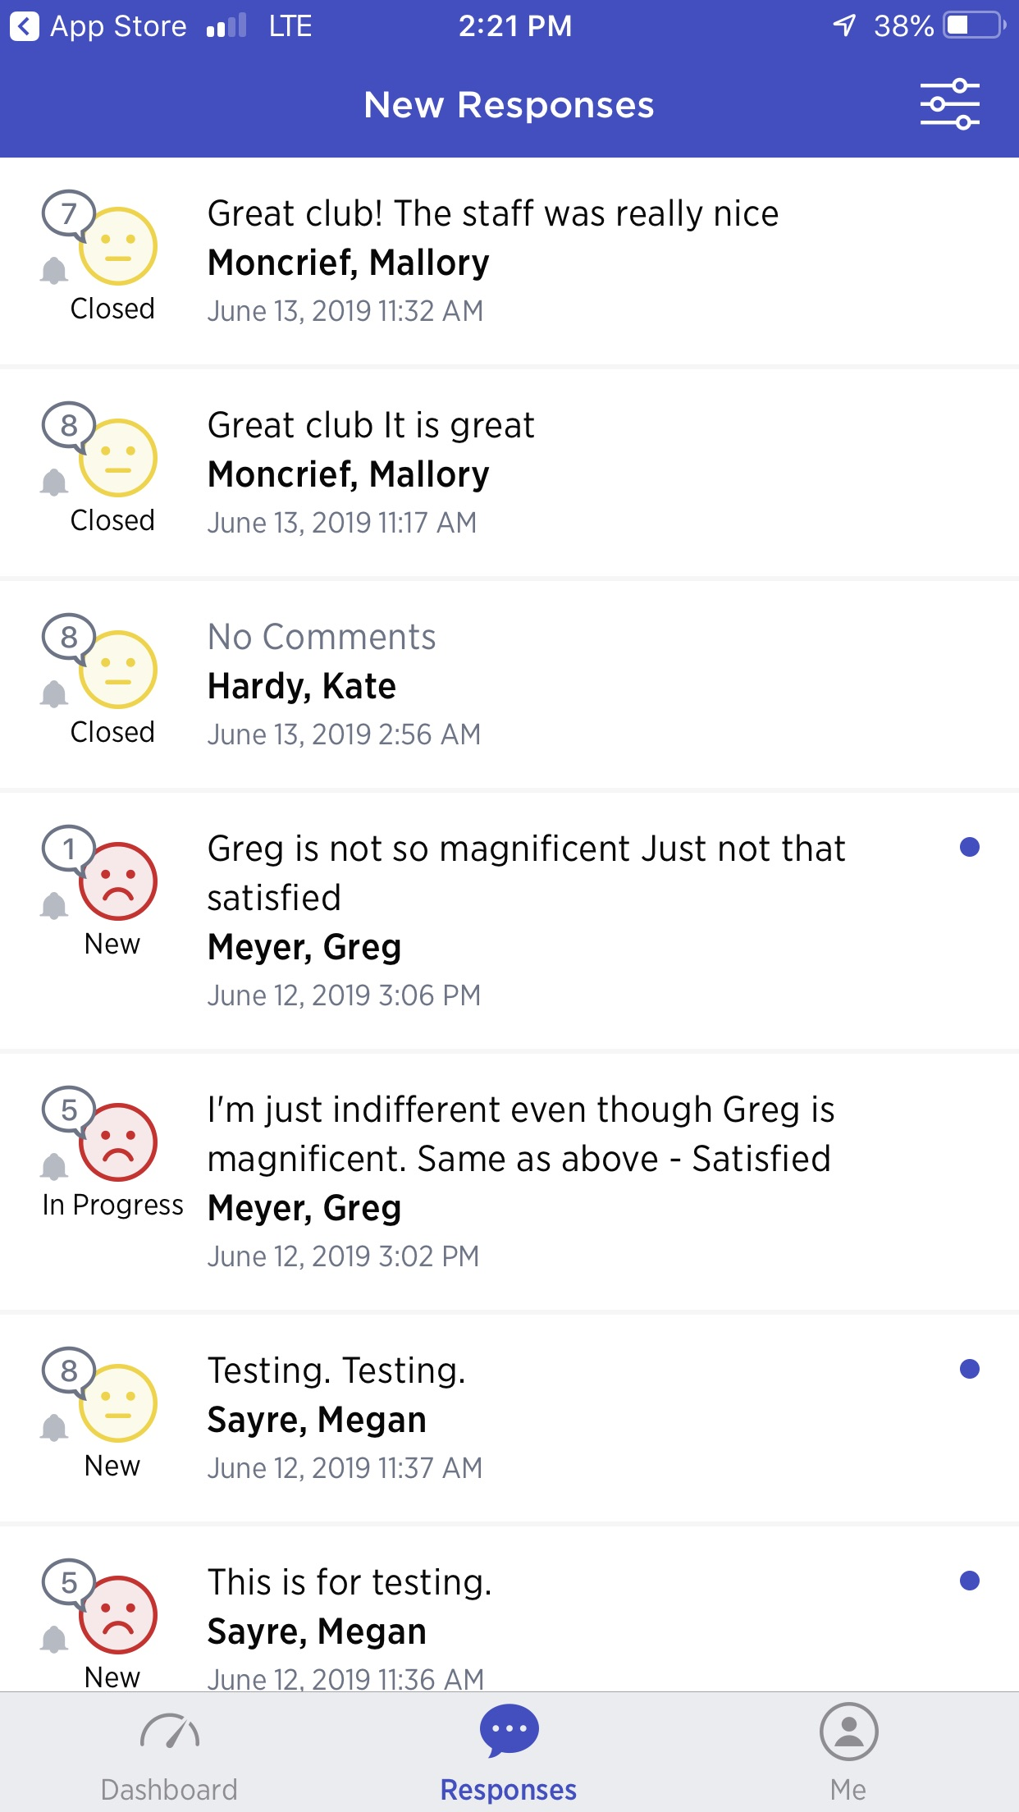
Medallia Mobile Responses
Instructions
You can see new responses in the app for follow up and viewing purposes.
You can view status of follow up (‘New’, ‘In Progress’ and ‘Closed’).
You can also review and close the loop directly within the app.

Slide 7
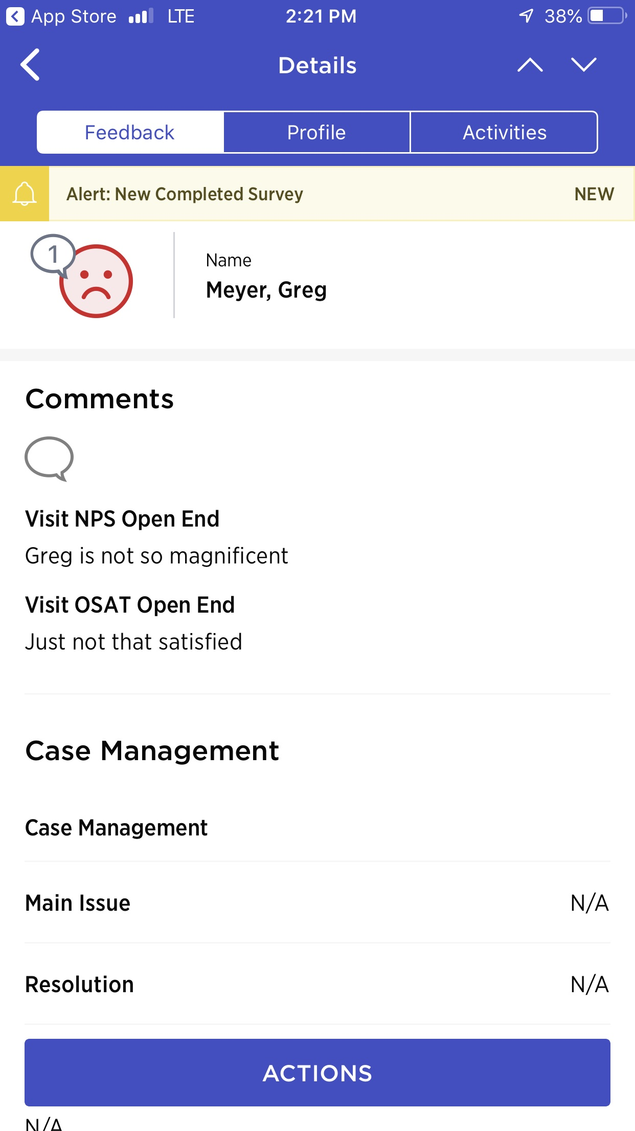
Medallia Mobile Responses
Instructions
Within an individual response you can select the ‘Main Issue’ and ‘Resolution’ actions taken by the club.
By selecting ‘ACTIONS’ you can take steps towards closing the loop with a member.

Slide 8
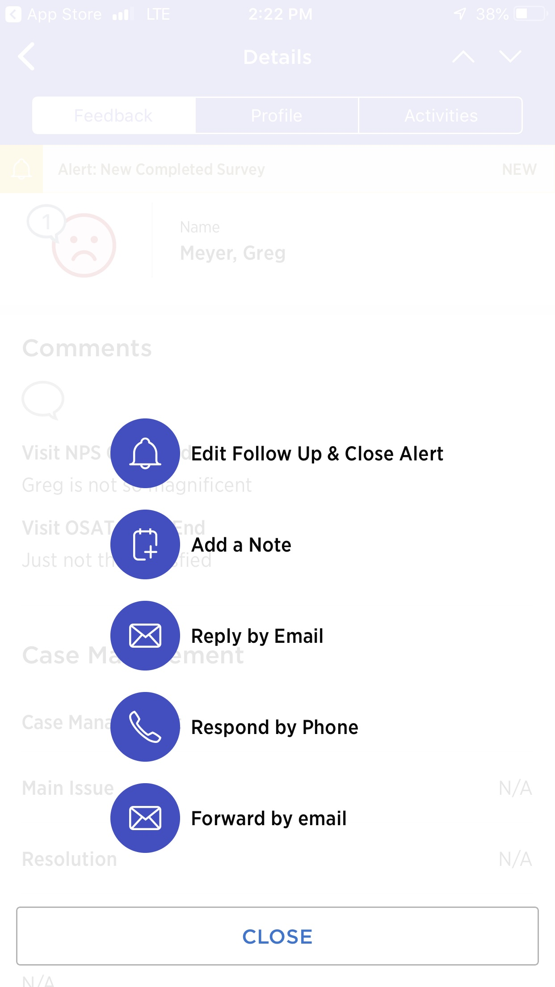
Medallia Mobile Responses
Instructions
Edit follow up alert allows you to change main issue and resolution.
Add a note if there is something specific you want to include with this response.
Reply by Email will allow you to use one of the Rapid Response Templates to email a member.
Respond by Phone will prompt the member phone number if provided.
Forward by email allows you to forward the response to another team member.

